Slide 1
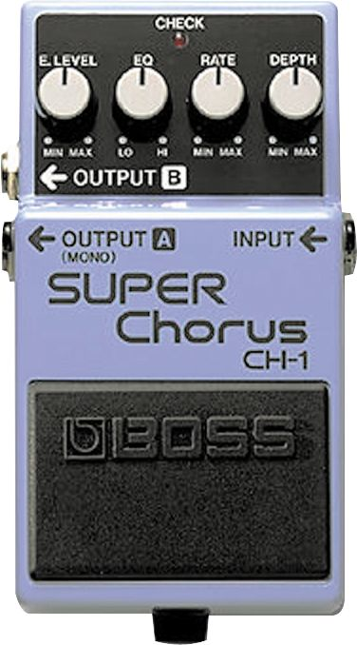
Chorus

Slide 2

The chorus effect
Chorus = a group of singers
Chorus effect
Make one instrument sound like many played together
Adds thickness to the sound
Often described as ‘lush’ or ‘rich’
A dry chord progression, followed by a chorused version
Notes:
Just as a chorus is a group of singers, the chorus effect can make a single instrument sound like there are actually several instruments being played. It adds some thickness to the sound, and is often described as 'lush' or 'rich'. This is an example of the chorus effect in action.

Slide 3
How it works
Two people playing instruments in unison:
Won’t be precisely synchronised
Some delay between sounds they produce
Instrument pitches deviate, despite careful tuning
Chorus effect reproduces these irregularities
Slight delay (implemented with delay line)
Detuning
Variable delay, like flanger and vibrato
Picture delay as recording device.
Store exact copy of input signal as it arrives, outputs later at same rate
Notes:
The algorithm behind the chorus effect isn't a spectacular or amazing trick - it's actually fairly simple. What happens when two people play instruments in unison? Well they are not always playing in precise synchronization, so there is some delay between the sounds they produce. In addition, the pitch of the two instruments can deviate somewhat, despite careful tuning. These are the functions that your chorus effect is reproducing.
This slight delay can be easily implemented with a delay line. Creating the detuning effect may not seem very simple at first, but it can be achieved by transforming the simple delay line into a variable length delay line. The 'variable length' part just means that the delay time changes over time, though it's effect on the pitch may not be very clear at first.

Slide 4
Chorus and flanger
Mix original signal with delayed and pitch modulated copy
Similar to flanger, except
Delay times in chorus are larger than in flanger
Chorus delay between 20-30ms
Flanger delay usually 1-10ms
Long delay doesn't produce sweeping sound of flanger
For chorus, generally no feedback used
LFO
x[n]
y[n]
Delay M(n)
g
+

Slide 5
Chorus and LFO
Delay time changes with low frequency oscillator
Periodic waveform (e.g. sine, triangle)
Waveform changes slowly (3 Hz and below)
LFO controls:
Frequency
Amplitude
Shape (waveform)
Can use randomly changing delay instead of LFO
Arguably, better models musicians playing in unison
Multiple players in unison show loudness differences
Can vary amplitude of delayed signal
Amplitude parameter could be controlled by another LFO
LFO
x[n]
y[n]
Delay M(n)
g
+

Slide 6
Common parameters
Delay
Controls minimum delay time that is used
For very small delay, chorus acts as flanger
Typical delay times between 20 and 30ms.
Sweep width (or depth)
Controls how much total delay time changes over time
Expressed in milliseconds
Max delay: sum of sweep width and ‘delay’ setting
Think of sweep depth as amplitude of LFO
Total
delay
Sweep
Width
(LFO amplitude)
LFO Period
Delay
parameter
Time

Slide 7
Common parameters
Sweep width (continued)
Have to read faster/slower to cover total change in time
Increased sweep widths increase pitch modulation
Large sweep depths create a ‘warble’
LFO (Low Frequency Oscillator) settings
Waveform describes how delay changes over time
Max of waveform = max delay time
Increasing LFO value = lower pitch (reading slower)
Pitch modulation related to speed of LFO (as before)
Steepest portions on waveform produce large pitch modulation
Increase speed→ compress waveform→ steeper→ pitch altered more
Sustained note- processed with chorus with 3 ms sweep width, then with6 ms sweep width
Notes:
The sweep depth also increases the pitch modulation introduced by the time-varying delay line. This happens because you have to read even faster and slower to cover the total change in time. Large sweep depths will create a 'warble.' The sound example demonstrates this effect.
The LFO waveform shows how the delay changes over time. When the waveform reaches a maximum, then the delay is at its largest value. When the waveform (and total delay time) is increasing, the pitch becomes lower. The amount of pitch modulation introduced by the chorus is related to how quickly the LFO waveform changes - the steepest portions on the waveform produce a large amount of pitch modulation, while the relatively flat portions have very little or no effect on the pitch. We can use this view to understand how the sweep depth varies the pitch. If you increase the sweep depth, you are effectively stretching the waveform vertically, which makes it steeper, and thus, the pitch is altered more.

Slide 8
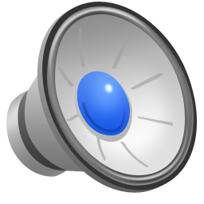
LFO waveform
Sine
Smooth
Continuously changing, both pitch and delay
Triangle
Only 2 pitches because only 2 slopes (positive and negative)
Sudden change between pitches
Log (exponential)
Smooth over cycle, but jump at end of each cycle
Slope at beginning and end of waveform differ
Causes abrupt change in pitch
Large sweep width stresses LFO effect
Sustained note processed with chorus using sine, triangle, and logarithm curve

Slide 9
More parameters
Number of voices
Multiple copies of sound
Model more than 2 instruments being played
Multi-voice chorus uses single LFO waveform for all voices
Each voice has different phase
At any point in time, each voice is at different point in waveform
Different delay times
If all in phase, same effect as single voice chorus with increased level
x[n]
y[n]
+
LFO
Delay M₁(n)
g₁
LFO
Delay M₂(n)
g₂

Slide 10

Stereo chorus
Run 2 monophonic choruses in quadrature phase
Same delay, width, etc.
Each LFO differs in phase by 90° (1/4 wavelength)
Sound arriving at each ear is different
Creates wider sound
Same principle as stereo flanger
For multi-voice chorus
Create stereo chorus simply by panning voices away from centre of mix
Mono source file processed first by a monophonic chorus, and then a stereo chorus
Notes:
A stereo chorus is generally constructed by running two monophonic chorus run in quadrature phase. This simply means that the LFO in each monophonic flanger differ in phase by ninety degrees (or one-quarter of a wavelength). This technique creates a 'wider' sound because the sound arriving at each of your ears is different. Sound Set 4 presents a mono source file processed first by a monophonic chorus, and then a stereo chorus. (If you are having trouble hearing any difference, make sure your computer is generating a stereo output, and use a pair of headphones.)
Note that in a multi-voice chorus (where each voice is monophonic), you can effectively create a stereo chorus simply by panning the voices away from the center of the mix.

Slide 11
Aside: building real-time effects
Delay, Vibrato, Flanger, Chorus all use buffers to hold delayed audio samples
How long does buffer need to be?
As long as the maximum delay (for any point in the LFO cycle)
But how does audio get into the buffer?
Real-time audio systems break the stream into discrete buffers
Can usually set the buffer size for the audio device
How much data at a time comes from the device?
But this is different than the size of the delay buffer!
Audio Samples
Audio device buffer size

Slide 12

Aside: building real-time effects
The audio hardware, not your program, controls when sound is processed
You create a callback function to process audio
The system “calls you back” whenever there’s work to be done
The system will tell you the buffer size
i.e. how many audio samples are there to process right now?
Your job now is to process only those samples that just came in. Run your effect and return when finished.
But you might need to remember what happened previously!
callback function
...
audio device buffer size

Slide 13
Aside: building real-time effects
Audio Samples
Audio device buffer size
+
What happens if we need a delay longer than the audio buffer size?
This is why we allocate a separate delay buffer
Delay buffer holds the past M samples, regardless of how the audio device chooses to deliver them
What if the delay is shorter than the audio buffer size?
Same problem! Might need a sample from last time the callback function was run
So, always keep a separate delay buffer

